Slide 1
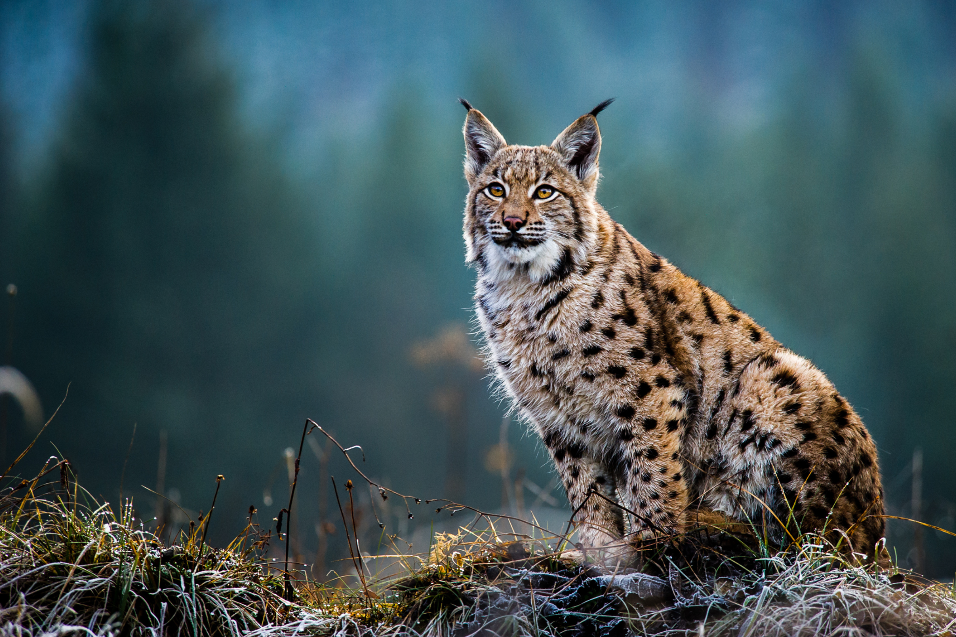
Did you know that we are more than half-way towards our next mass extinction event?
by Monika Radominska & Mar Sánchez
https://en.wikipedia.org/wiki/Extinction_event

Slide 2
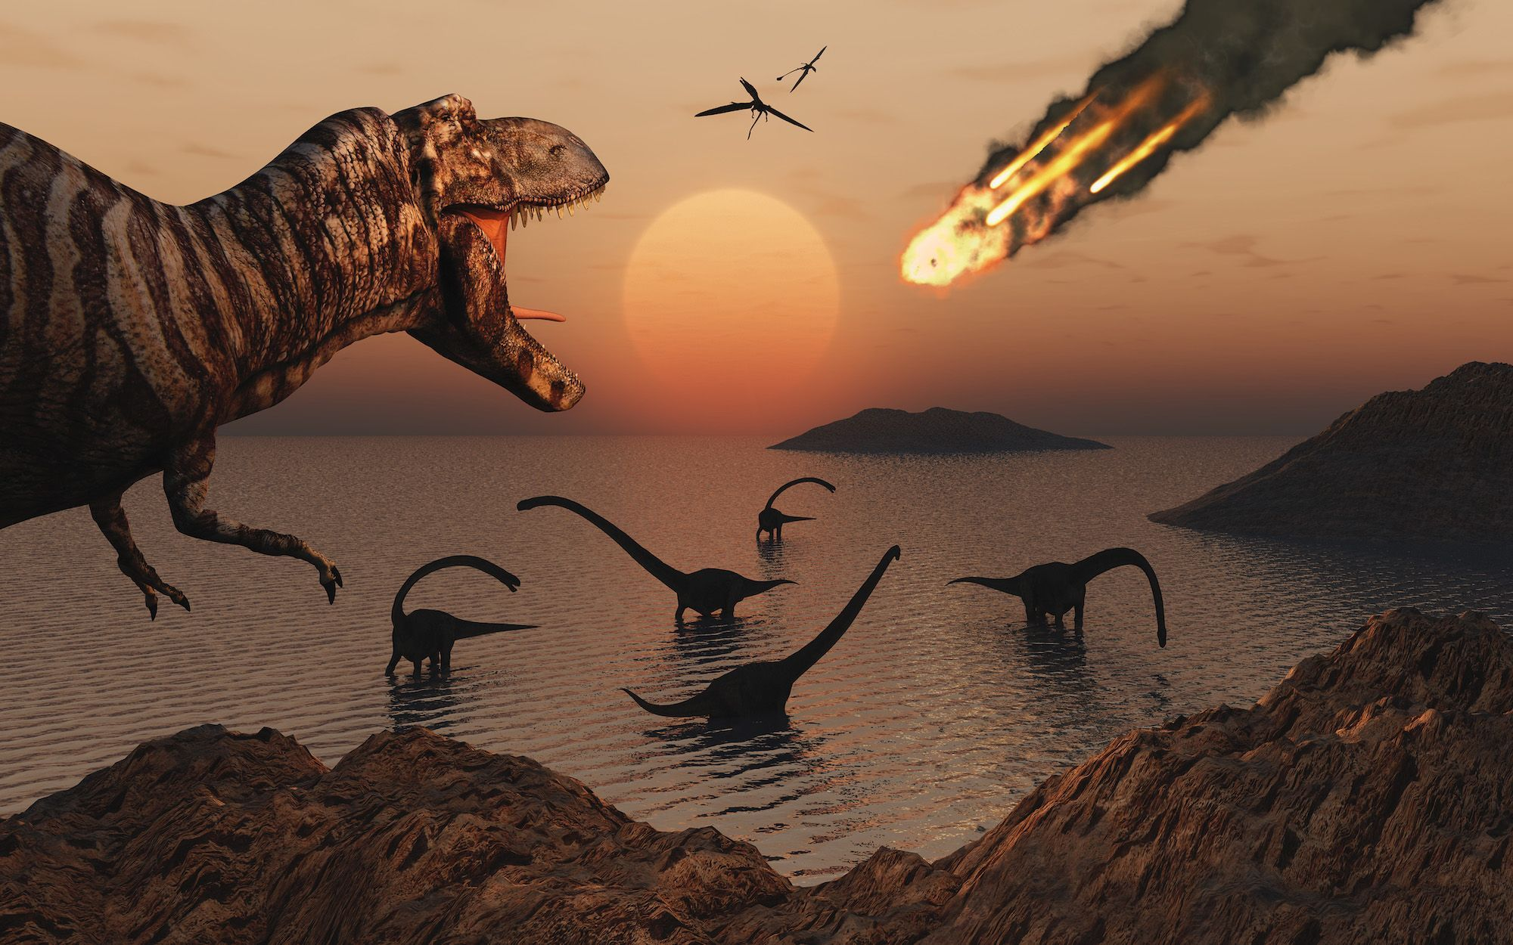
“A mass extinction event, any circumstance that results in the loss of a significant portion of Earth’s living species across a wide geographic area within a relatively short period of geologic time”

Slide 3
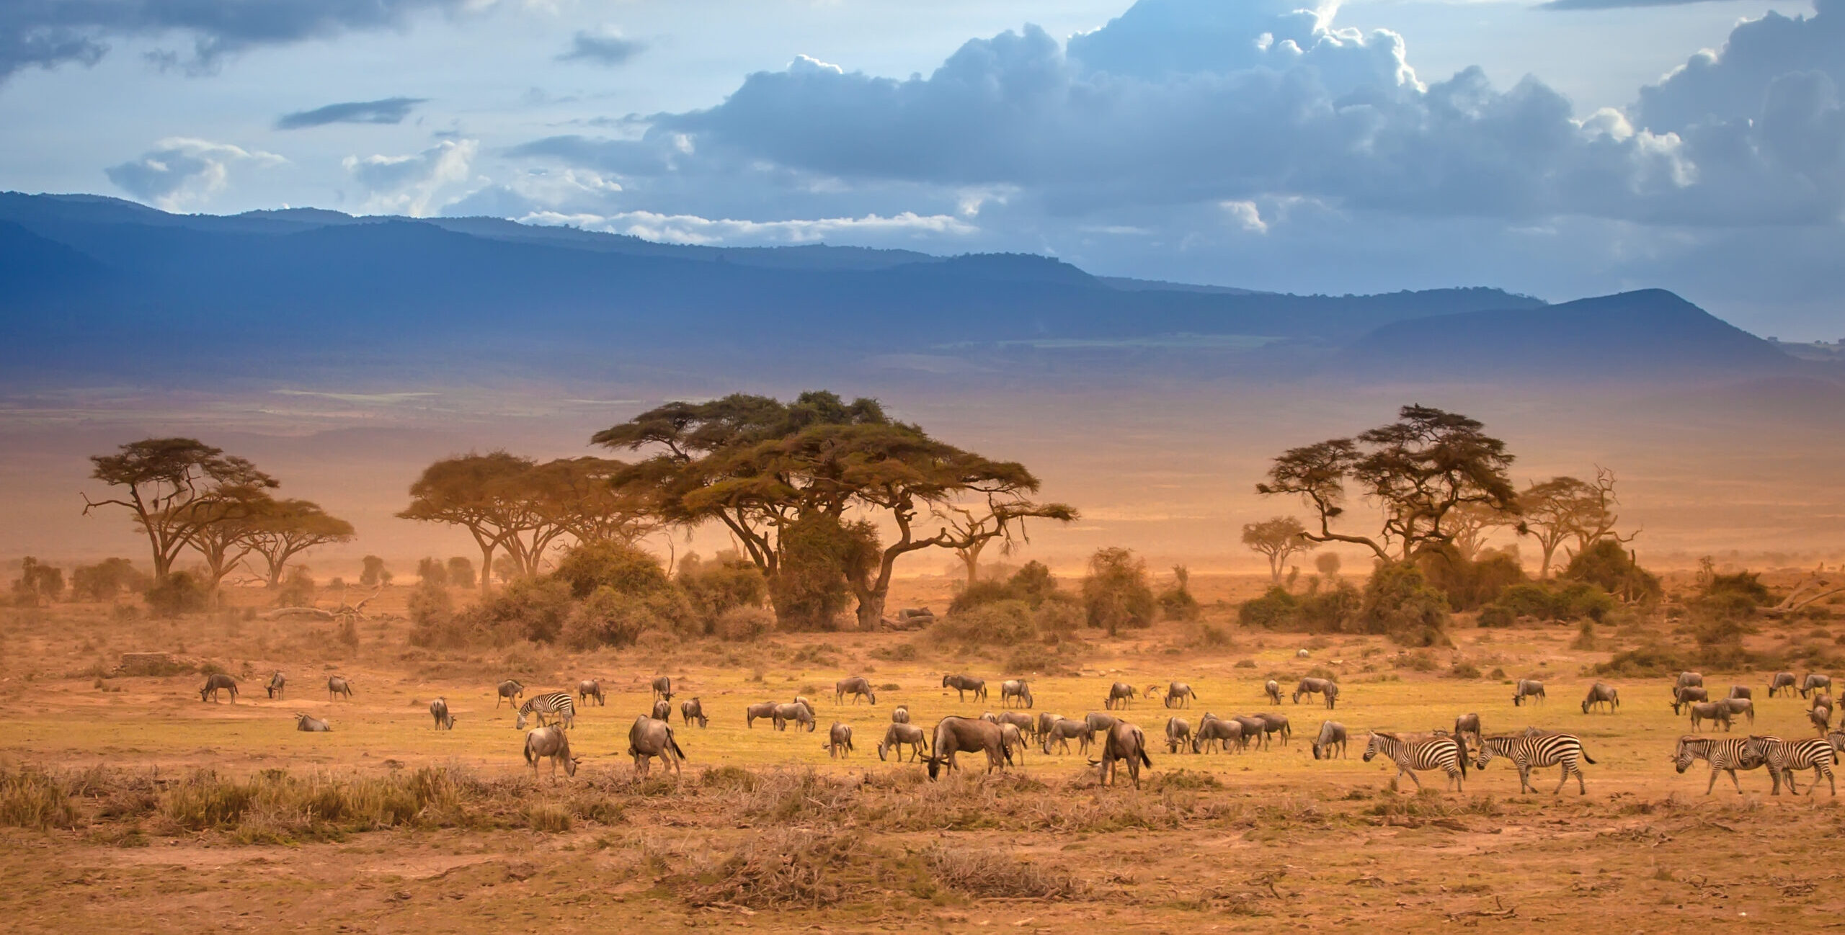

Slide 4
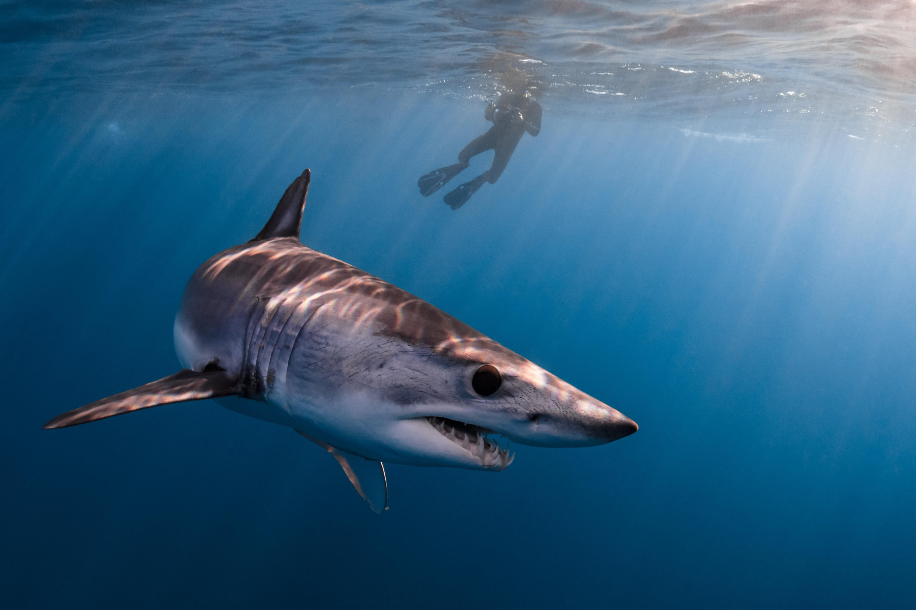
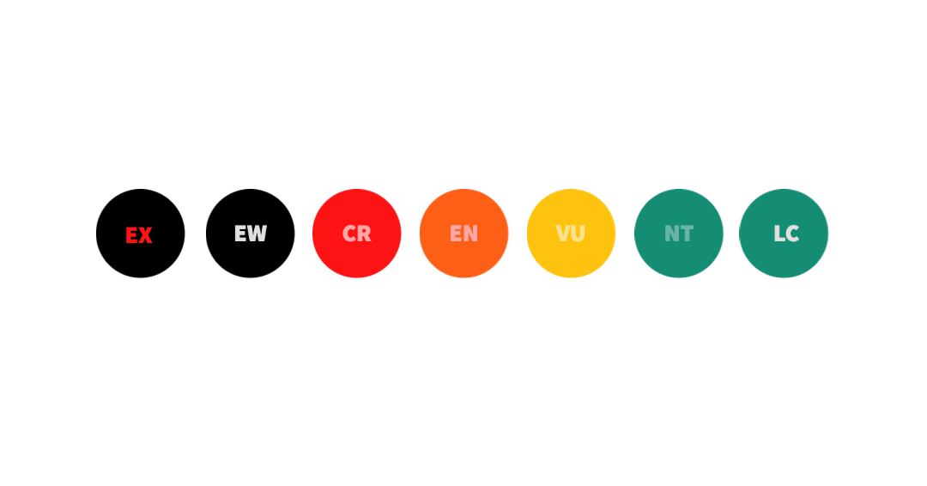
Human impacts:
destruction of habitats
overexploitation
climate change
nitrogen pollution
IUCN - The international Union for Conservation of Species

